Slide 1

BUS7C1 CORPORATE STRATEGY AND INTERNATIONAL MANAGEMENT
Lecture 4

Slide 2


Activity 1
https://PollEv.com/multiple_choice_polls/QYHX4Tdr8B9BRkWmphECJ/respond

Slide 3
The Emergence Of Competitive Advantage
How does competitive advantage emerge?
External Sources of Change e.g.
Changing customer demand
Changing prices of inputs
Technological Change
Internal source
Of Change
Resource heterogeneity
Among firms creates winner and loser
Some firms are faster and
More effective in exploiting change
Some firms have greater creative and innovative capacity

Slide 4
External Source of Change
Some changes have different implication for firm's base on their competitive position and can endow some firms, but not others, with a competitive advantage. E.g. Tesla Vs Jeep during Covid.
Other changes affect many firms in similar way , but some firms are better equipped to make use of them and establish a competitive advantage due to:
Superior ability to anticipate change. E.g. Business intelligence, insider information.
Superior ability to respond to change quickly. E.g. R&D in place, SME, agile supply chain.
Notes:
Business environments are constantly evolving, and changes—whether due to economic shifts, technological advancements, or crises like the Covid-19 pandemic—can affect firms differently based on their competitive position. Some firms can leverage these changes to gain a competitive advantage, while others struggle to adapt.
Tesla vs. Jeep During Covid-19: A Case Study
The Covid-19 pandemic had a profound impact on the automotive industry, but companies like Tesla and Jeep experienced these changes differently due to their distinct competitive positions.
Tesla: Capitalizing on Change
Tesla, known for its strong technological capabilities, direct-to-consumer sales model, and digital-first strategy, was well-positioned to navigate pandemic-related disruptions. Here’s why:
Digital Sales & Direct-to-Consumer Model: Unlike traditional automakers reliant on dealership networks, Tesla’s online sales model allowed customers to order vehicles without visiting physical locations, an advantage when lockdowns restricted movement.
Supply Chain Agility: While supply chain disruptions impacted all automakers, Tesla’s vertical integration strategy (e.g., manufacturing its own batteries and software) gave it more control over key components.
High Demand for Electric Vehicles (EVs): Growing environmental awareness and government incentives for EVs worked in Tesla’s favor, accelerating demand despite the pandemic.
Innovation & Market Perception: Tesla’s brand image as a tech innovator made it appealing to investors, leading to a surge in its stock price and access to additional capital.
Jeep: Facing Challenges Due to a Traditional Business Model
Jeep, a brand under Stellantis (formerly Fiat Chrysler), struggled more during the pandemic due to its reliance on traditional dealership sales, internal combustion engine (ICE) vehicles, and supply chain dependencies. Key challenges included:
Dependence on Dealerships: Jeep's sales structure relied heavily on physical dealerships, which saw reduced foot traffic due to lockdowns and restrictions.
Supply Chain Disruptions: Jeep faced significant production delays due to semiconductor shortages, a challenge exacerbated by reliance on external suppliers.
Less Demand for Gas-Powered Vehicles: Unlike Tesla, Jeep’s lineup primarily consisted of gas-powered SUVs, which were less aligned with the growing shift toward sustainability and government incentives for EVs.
Higher Production Costs: Jeep had to balance rising production costs with consumer affordability, making it harder to maintain profitability.
Key Takeaways: Competitive Position & Advantage in Times of Change
Business Model Matters: Firms with flexible, digital-driven business models (like Tesla) were better equipped to handle pandemic restrictions than those reliant on traditional retail channels (like Jeep).
Vertical Integration Enhances Resilience: Controlling critical aspects of the supply chain gives firms a competitive edge during disruptions.
Market Trends & Innovation Influence Competitive Advantage: Companies aligned with future trends (e.g., EV adoption, digitalization) benefit from structural changes in the industry.
Brand Positioning & Investor Confidence: Strong brand positioning and a reputation for innovation can help firms attract investment even during uncertain times.

Slide 5
Internal sources of change: Innovation
New Products or Service
New Inputs ( Electric car: Tesla)
New process ( Pilkington Glass)
New markets ( looking into other countries to sell your product or service)
New ways of Organising ( Amazon, Ebay)
Notes:
The introduction of innovative goods or services that create value for customers and differentiate a company from competitors.
Apple (iPhone): Revolutionized the mobile phone industry with a touchscreen smartphone and an app ecosystem.
Netflix: Transformed home entertainment by shifting from DVD rentals to a digital streaming service.
New Inputs (Electric Cars – Tesla)
The use of alternative materials, technologies, or components in production to enhance sustainability, efficiency, or cost-effectiveness.
Example:
Tesla disrupted the auto industry by replacing traditional gasoline-powered engines with electric batteries.
It further innovated by developing its own battery technology and investing in supercharger networks.
Governments worldwide now support EV adoption with tax incentives, boosting demand.
New Processes (Pilkington Glass)
The development of innovative production methods that improve efficiency, reduce costs, or enhance product quality.
Example: Pilkington Glass (Float Glass Process)
Pilkington revolutionized glass manufacturing by introducing the float glass process, enabling large-scale, high-quality glass production.
This process reduced defects, improved efficiency, and lowered costs, making glass more affordable and accessible.
New Markets (Global Expansion – Selling in Other Countries)
Expanding into new geographic regions to reach untapped customer segments and increase revenue.
Examples:
McDonald's in China & India: Adapted its menu to local tastes (e.g., McSpicy Paneer in India).
Tesla in Europe & China: Capitalized on growing EV demand in environmentally conscious markets.
Starbucks in Africa & the Middle East: Entered emerging markets by creating premium coffee culture experiences.
New Ways of Organizing (Amazon, eBay – Digital & Platform-Based Business Models)
Definition: Restructuring business operations through digital transformation, platform-based ecosystems, or decentralized models.
Examples:
Amazon (E-commerce & Cloud Computing): Revolutionized retail by shifting sales online and expanding into cloud services (AWS).
eBay (Marketplace Model): Created a peer-to-peer business model, allowing consumers to buy and sell products with minimal company involvement.
Uber & Airbnb (Platform Economy): Leveraged digital platforms to disrupt the transportation and hospitality industries.
Innovation is not just about new products—it can involve processes, materials, business models, and markets. Companies that continuously innovate stay ahead of competition, while those that resist change may struggle (e.g., Kodak). Adapting to change requires balancing risk and opportunity—some innovations succeed, while others fail.

Slide 6
HOW IS COMPETITIVE ADVANTAGE ESTABLISHED?
Blue Ocean Strategy
Can bring new value proposition – Raise, Reduce, Eliminate, Create
Raise
What factors should be raised well above the industry’s standard?
Eliminate
What factors that the industry has long competed on should be eliminated?
Reduce
Which factors should be reduced well below the industry’s standard?
Create
Which factors should be crated that the industry has never offered?
Notes:
The Blue Ocean Strategy, introduced by W. Chan Kim and Renée Mauborgne, focuses on creating uncontested market space rather than competing in crowded and highly competitive industries (Red Oceans). It encourages businesses to innovate and differentiate by offering new value propositions that redefine industry boundaries.
One of the key frameworks of this strategy is the Four Actions Framework (Raise, Eliminate, Reduce, Create), which helps companies reimagine their value proposition by shifting focus from traditional competition to innovation.
Raise: What Factors Should Be Raised Well Above the Industry Standard?
These are areas where businesses can excel beyond industry expectations to create a superior value proposition. Raising certain factors can lead to enhanced customer experience, better product performance, or unique service offerings.
Examples:
Tesla (Electric Vehicles) – Raised the importance of battery range and autonomous driving technology compared to traditional car manufacturers.
Apple (iPhone & MacBooks) – Raised user experience and ecosystem integration, making seamless connectivity between devices a key differentiator.
Luxury Hotels (Ritz-Carlton, Four Seasons) – Raised the standard of customer service and personalized experiences, making hospitality a luxury experience.
Eliminate: What Factors That the Industry Has Long Competed On Should Be Eliminated?
Eliminating unnecessary features, processes, or traditions can reduce costs and simplify the value proposition for customers. Companies often eliminate aspects that no longer provide value or create inefficiencies.
Examples:
Cirque du Soleil (Entertainment Industry) – Eliminated animals in circus performances, shifting focus to acrobatics and artistic storytelling.
Netflix (Streaming vs. Cable TV) – Eliminated commercials and rigid programming schedules, allowing users to watch content on demand.
Budget Airlines (Ryanair, Southwest Airlines) – Eliminated free meals, assigned seating, and multiple class options to lower costs and offer affordable travel.
Reduce: Which Factors Should Be Reduced Well Below the Industry Standard?
Reducing elements that customers find unnecessary or overpriced can help streamline operations and improve cost efficiency while still delivering a competitive product.
Examples:
IKEA (Furniture Retail) – Reduced customer service and assembly assistance, shifting responsibility to consumers while offering lower prices.
Uber & Lyft (Taxi Industry Disruption) – Reduced formal driver training and regulation costs, allowing more drivers to enter the market.
Amazon Go (Retail Shopping) – Reduced cashiers and checkout lines, leveraging automation and AI-powered stores.
Create: Which Factors Should Be Created That the Industry Has Never Offered?
Creating new factors that redefine customer expectations and unlock new demand is a key part of a Blue Ocean Strategy. This often leads to market leadership and innovation.
Examples:
Tesla (EV Market) – Created over-the-air software updates, allowing cars to improve over time with new features.
Apple (App Store Ecosystem) – Created a centralized digital marketplace for apps, revolutionizing software distribution.
Airbnb (Hospitality) – Created a peer-to-peer home-sharing model, giving travelers unique and affordable accommodation options.

Slide 7
Blue Ocean Strategy
https://www.youtube.com/watch?v=sYdaa02CS5E&t=70s

Slide 8
Competitive Advantage from Internally-Generated Change: Strategic Innovation
STRATEGIC INNOVATION: creating customer value from new products, experiences, or modes of product delivery
Innovatory strategies may involve:
Creating whole new markets/industries (e.g. Craig McCaw and wireless telephony services; My Space and Facebook in social networking)
Creating new customer segments (e.g. AirAsia in low-cost air travel in SE Asia; Nintendo’s Wii games console;)
New sources of competitive advantage
Reconfiguring the value chain: Zara in fashion clothing; Southwest in airlines; Cemex in cement; IKEA in furniture
Reconceptualizing the product: Cirque du Soleil in circuses; Starbucks in coffee shops; Apple in computers (iPad)
New performance combinations : e.g. Low prices with quality (Virgin Atlantic); low prices and style (H&M, Primark, Target)
Notes:
Strategic innovation is about creating customer value by introducing new products, experiences, or delivery methods that redefine industries. It goes beyond incremental improvements—it involves fundamental shifts in business models, markets, or customer perceptions. Companies that adopt strategic innovation disrupt traditional markets, attract new customers, and establish competitive advantages.
Innovatory strategies may involve:
Creating whole new markets or industries
Identifying new customer segments
Developing new sources of competitive advantage
Reconfiguring the value chain
Reconceptualizing products or services
Combining performance dimensions (e.g., low price + high quality)
Creating Whole New Markets & Industries
Some businesses innovate by introducing products or services that never existed before, creating entirely new industries.
Examples:
Craig McCaw (Wireless Telephony Services) – Pioneered mobile telecommunications, shifting consumers away from landlines.
MySpace & Facebook (Social Networking) – Redefined communication by making social networking a digital necessity.
Uber & Airbnb – Created new business models in transportation and hospitality without owning taxis or hotels.
Creating New Customer Segments
Strategic innovators often target underserved or entirely new customer groups, expanding market reach.
Examples:
AirAsia (Low-Cost Air Travel in SE Asia) – Made flying accessible to budget-conscious travelers.
Nintendo Wii – Expanded gaming beyond hardcore gamers to families and casual players.
Peloton (Fitness Tech) – Brought interactive workouts to home users, redefining the fitness industry.
Developing New Sources of Competitive Advantage
Companies that innovate strategically build advantages beyond cost or product differentiation. This may involve superior technology, branding, network effects, or ecosystem strategies.
Examples:
Amazon (E-commerce + AWS) – Leveraged logistics, AI, and cloud computing for dominance.
Tesla (EV Market & Autonomous Driving) – Combines sustainability, battery technology, and software for a tech-driven competitive edge.
Google (AI & Search Data) – Uses machine learning and vast data networks to improve search and advertising.
Reconfiguring the Value Chain
Strategic innovation can also come from changing how products are made, distributed, or sold to improve efficiency and cost-effectiveness.
Examples:
Zara (Fashion Clothing) – Shortened supply chains to react quickly to fashion trends.
Southwest Airlines (Low-Cost Travel) – Eliminated hub-and-spoke models to increase efficiency.
IKEA (Furniture) – Used flat-pack design and self-assembly to cut costs while offering stylish furniture.
Reconceptualizing the Product or Service
Sometimes, innovation is not about creating something new but about rethinking what already exists in a way that enhances customer value.
Examples:
Cirque du Soleil (Circus Industry) – Removed animals and focused on theatrical storytelling and acrobatics.
Starbucks (Coffee Shops) – Turned coffee from a commodity into a premium experience with ambiance.
Apple (Computing & Mobile Devices) – Revolutionized personal computing, smartphones, and tablets through user-centric design.
New Performance Combinations
Some companies disrupt industries by offering an unexpected mix of attributes—combining low prices with style or quality.
Examples:
Virgin Atlantic (Air Travel) – Offered luxury service at competitive prices.
H&M, Primark, Target (Fashion Retail) – Delivered stylish clothing at low costs through smart sourcing.
Xiaomi (Smartphones) – Balanced affordability with high-tech features, gaining global traction.
Strategic innovation is not just about new products—it’s about rethinking entire industries, customer segments, business models, and value chains.

Slide 9
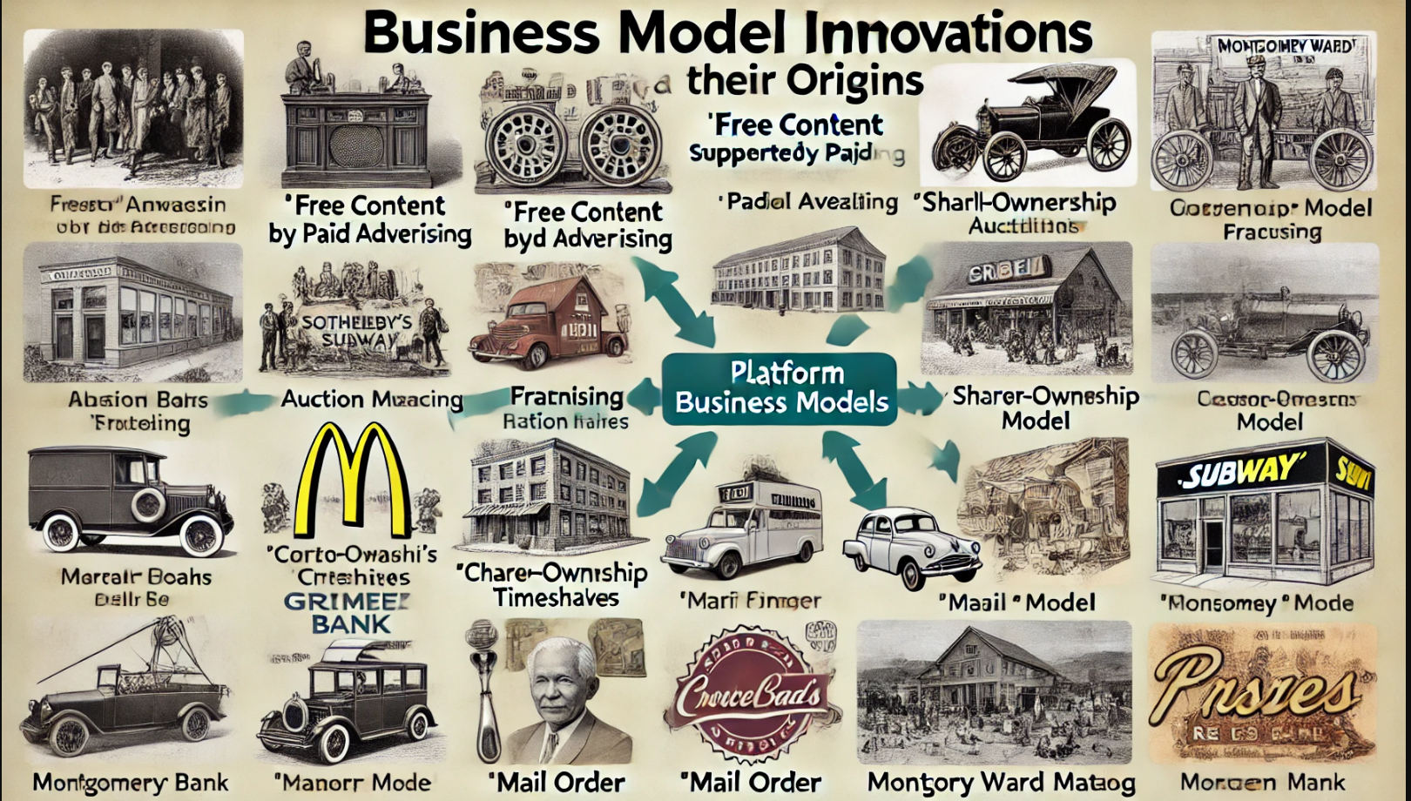
Historical Origins of Business Model Innovations
Notes:
Free Content Supported by Paid Advertising
Origin: U.S. commercial radio in the early 1920s
Explanation: This model emerged as radio stations realized they could offer free content to listeners and generate revenue by selling advertising slots. It's now widely used in digital media, including social platforms, podcasts, and online news.
Platform Business Models
Origin: Auction houses like Sotheby’s (1744) and Christies (1766)
Explanation: Platform businesses connect multiple parties to create value. Auction houses served as the early examples, where buyers and sellers could meet. Today, platforms like eBay, Uber, and Airbnb follow this model.
Shared-Ownership Models
Origin: Real estate timeshares in the 1960s
Explanation: Shared-ownership allows individuals to co-own a product or service. Examples today include Airbnb (shared living spaces), Zipcar (shared cars), and Netjets (fractional jet ownership).
Franchising
Origin: Singer Sewing Machine Company’s global network of franchised dealers in the 1880s
Explanation: Franchising allows a business to expand rapidly by licensing its brand and operational model to independent operators. McDonald's and Subway are classic examples.
Consumer Cooperatives
Origin: The Rochdale Society of Equitable Pioneers in 1844
Explanation: Cooperatives are businesses owned and run by the consumers themselves. The Rochdale Society is one of the earliest examples, and today we see modern co-ops like REI.
Microfinance
Origin: Grameen Bank, founded by Muhammad Yunus in the 1970s
Explanation: Microfinance provides small loans to individuals in poverty to start or expand small businesses. The Grameen Bank helped spark this model, which has grown worldwide.
Tied Products (Razor-and-Blades Model)
Origin: Introduced by Gillette’s competitors in 1910
Explanation: The model involves selling a durable product (razor) at a low price and generating ongoing revenue by selling related consumable products (blades). It's used today by companies like printers (cheap printers, expensive ink).
Mail Order
Origin: Montgomery Ward in 1872
Explanation: The mail-order model allows businesses to sell products through catalogs and deliver them via mail. This model evolved into e-commerce, with companies like Amazon.

Slide 10
Sustaining Competitive Advantage: Types of Isolating Mechanisms
Requirement for Imitation
Isolating Mechanism
Identification
Obscure superior performance. E.g., Public or not !!
Incentives for imitation
Deterrence: signal aggressive intentions to imitators E.g., Apple Vs Samsung
Pre-emption: Exploit all available investments opportunities E.g., Food Products
Diagnosis
Rely upon multiple sources of competitive advantages to create “causal ambiguity”
E.g., Toyota in US and Big Three
Resource acquisition
Base competitive advantage upon resources and capabilities that are immobile and difficult to replicate.

Slide 11
Porter’s Generic Strategies
Cost Leadership Strategy
Differentiation Strategy
Focus Strategy
Competitive Advantage
Notes:
Porter’s Generic Strategies is a framework developed by Michael E. Porter in 1980 to help businesses gain a competitive advantage in their respective industries. The framework outlines three primary strategies—Cost Leadership, Differentiation, and Focus—along with an additional focus on competitive advantage as the central driver behind business success. Below is an overview of the framework, including the source of competitive advantage for each strategy:
1. Cost Leadership Strategy
The Cost Leadership strategy focuses on becoming the lowest-cost producer in an industry. Companies using this strategy aim to reduce their operating costs through economies of scale, efficient production techniques, and cost-saving innovations. The goal is to offer products or services at the lowest possible price while maintaining acceptable quality.
Source of Competitive Advantage:
Cost Efficiency: The primary source of competitive advantage is the ability to produce goods or services at a lower cost than competitors, which allows the company to either charge lower prices or maintain higher profit margins.
Economies of Scale: Larger production volumes lead to a reduction in cost per unit. Companies that achieve economies of scale can spread their fixed costs over a large number of units, reducing the overall cost structure.
Efficient Operations: Streamlined processes and the use of technology and automation can reduce waste and operational costs.
2. Differentiation Strategy
The Differentiation strategy involves offering unique products or services that are perceived by customers as superior or distinct in some way from those offered by competitors. This could involve superior quality, features, customer service, brand image, or technological innovation. The aim is to create a competitive advantage through uniqueness rather than cost.
Source of Competitive Advantage:
Perceived Value: The key to success in differentiation is creating products that customers perceive as valuable, unique, or premium. This can justify charging higher prices compared to competitors.
Innovation and Branding: Innovation in design, technology, or customer experience can create a strong differentiation advantage. Strong branding further reinforces the uniqueness of the product.
Customer Loyalty: Differentiation can lead to strong brand loyalty, where customers prefer a company’s product even if it costs more. This loyalty can help companies maintain premium pricing.
3. Focus Strategy
The Focus strategy involves concentrating on a particular market segment or niche rather than targeting the entire market. Companies employing this strategy may either focus on cost leadership (cost focus) or differentiation (differentiation focus) within the chosen niche. The idea is to serve the specific needs of the niche market better than competitors who may target a broader audience.
Source of Competitive Advantage:
Specialized Knowledge: Firms using a focus strategy often have deep expertise in the niche market, allowing them to better understand and meet the unique needs of the segment.
Targeted Marketing: By focusing on a narrow segment, businesses can tailor their products, services, and marketing efforts to precisely meet the needs of that group, improving customer satisfaction and loyalty.
Cost or Differentiation within Niche: Companies can either pursue cost leadership or differentiation, but only within the specific niche, allowing them to outperform competitors in that area. Cost-focused firms can dominate niche markets by being the low-cost producer, while differentiation-focused firms can create unique offerings for the niche market.
4. Competitive Advantage
The source of competitive advantage in Porter’s framework is the ability to perform activities in a way that competitors cannot replicate or easily imitate. Competitive advantage arises when a company has resources, capabilities, or business processes that enable it to outperform competitors consistently. In Porter’s model, competitive advantage is grounded in two dimensions:
Cost Advantage: Achieved through cost leadership, where a company has the lowest cost of operation in the industry.
Differentiation Advantage: Achieved through differentiation, where a company’s products or services are perceived as superior, allowing it to command a premium price.
Porter's Generic Strategies provide a strategic blueprint for companies to gain a competitive edge. Whether through cost leadership, differentiation, or focus, the central tenet is understanding the source of competitive advantage—whether it's through cost efficiency, unique offerings, or market specialization. Firms need to carefully assess their internal capabilities, market conditions, and customer preferences to decide which strategy to pursue for long-term success. Balancing these strategies effectively can lead to strong market positioning and sustained profitability.

Slide 12
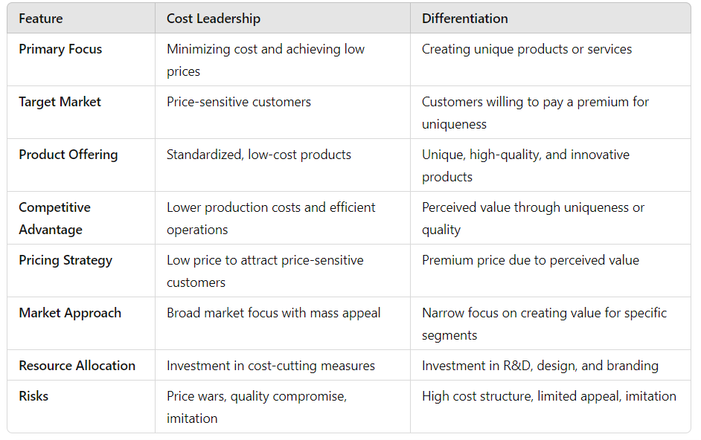
Comparison of Cost Leadership and Differentiation Strategies
Notes:
The Cost Leadership and Differentiation strategies are two of the primary approaches outlined in Porter's Generic Strategies framework. Both strategies aim to achieve a competitive advantage but do so through different means. Below are the features of each strategy:
The Cost Leadership strategy is focused on achieving the lowest cost of production and offering products or services at a competitive price while maintaining acceptable quality. This strategy is particularly effective in industries with price-sensitive customers and where cost efficiency is a key driver of success.
Key Features of Cost Leadership:
Efficiency in Operations: Firms use streamlined processes, automation, and economies of scale to reduce costs. This can involve optimizing production, distribution, and supply chain operations.
Low-Cost Production
The focus is on reducing direct and indirect costs at every level of the business. This includes raw material costs, labor, overheads, and production costs.
Economies of Scale: Larger volumes of production allow businesses to spread fixed costs (such as manufacturing or marketing) over a wider number of units, which reduces per-unit costs.
Standardized Products: Often, cost leaders offer standardized products with fewer options or variations to reduce complexity and cost. The goal is mass production, which results in savings.
Cost-Control Culture: Companies adopting this strategy often develop a culture of cost control, where every department and employee is focused on minimizing costs.
Price Competitiveness: By having the lowest cost base, businesses can offer their products or services at competitive prices, often leading to higher market share in price-sensitive segments.
Strong Supplier Relationships: Cost leaders often negotiate better terms with suppliers, benefiting from bulk purchasing and long-term agreements to reduce input costs.
Limited Differentiation: Since the main focus is on price, cost leaders usually offer products that are comparable to competitors but without extra features or premium elements.
Risks of Cost Leadership:
Cost-cutting too much can affect product quality, which may harm the brand.
Competitors can mimic cost-cutting methods or lower their prices.
Dependence on volume can be risky if demand falls.
The Differentiation strategy focuses on offering unique products or services that are valued by customers and perceived as distinct from competitors’ offerings. The goal is to create a competitive advantage by making a product or service more attractive through various factors other than price.
Key Features of Differentiation:
Unique Product/Service Features: The company focuses on offering something different—whether it's product features, design, technology, or additional services—that distinguishes it from competitors.
Innovation: Differentiators often rely on innovation to create a unique position in the market. This could be through new technologies, creative design, or continuous product development.
Branding and Reputation: Strong branding is key to differentiation. Companies invest in building a brand image that communicates quality, prestige, or uniqueness, leading to customer loyalty.
Customer Perception: Differentiation is often built on the perception of superior quality, value, or experience. Customers are willing to pay a premium for products they believe offer something special.
Premium Pricing: Since differentiated products are unique, they can often be sold at higher prices, allowing businesses to achieve higher margins compared to competitors offering standard products.
High-Quality Standards: Differentiators often emphasize superior quality in their products or services, ensuring they meet higher-than-average standards in design, performance, or customer service.
Customer Service: Exceptional customer service and support are often part of a differentiation strategy. Providing after-sales service, warranties, or personalized attention can make a product stand out.
Focus on Niche Markets: Some firms use differentiation to cater to specific market segments, offering customized products or services that meet the unique needs of these groups.
Risks of Differentiation:
High Costs: Investment in innovation, high-quality materials, and branding can lead to increased production and marketing costs.
Imitation by Competitors: If the differentiation is not protected (e.g., through patents or trademarks), competitors can copy the features and offer similar products.
Narrow Market Appeal: If the unique features are too niche, they may not appeal to the broader market, limiting sales volume.

Slide 13
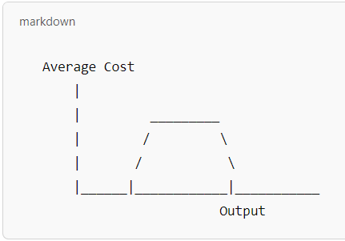
Economies of Scale: The Long-Run Cost Curve for a Plant
The long-run cost curve typically looks like a U-shape. Here's how it works:
The left portion of the curve is downward-sloping, representing economies of scale, where average costs decrease as output increases.
The middle portion of the curve is flat, indicating constant returns to scale, where output increases without any change in average costs.
The right portion of the curve slopes upward, representing diseconomies of scale, where further increases in output lead to higher average costs.
Left side of the curve (decreasing): Represents economies of scale.
Flat middle: Represents constant returns to scale.
Right side of the curve (increasing): Represents diseconomies of scale.
Notes:
Economies of Scale refer to the cost advantages that a firm experiences when it increases the scale of production. As a company produces more units of a good or service, the average cost of production typically decreases due to the spreading of fixed costs over more units and other factors like specialization and bulk purchasing.
In the context of a long-run cost curve, the relationship between economies of scale and the cost structure of a firm is illustrated.
Understanding Economies of Scale
Economies of Scale occur when increasing production results in a decrease in the cost per unit of output. There are several factors contributing to economies of scale:
Technical Factors: Increased production allows for more efficient use of equipment, facilities, and labor.
Managerial Specialization: As firms grow, they can hire specialized managers or workers who can operate more efficiently.
Bulk Purchasing: Larger firms can negotiate lower input costs through bulk purchasing of raw materials or components.
Financial Economies: Bigger firms can access cheaper financing due to their scale and reduced risk profile.
Marketing Economies: Firms can spread advertising costs over a larger output, reducing the cost per unit of marketing.
The Long-Run Cost Curve
The long-run cost curve represents the lowest possible cost at which a firm can produce a given quantity of output when it has the flexibility to vary all of its inputs (i.e., it is not constrained by fixed resources like in the short-run). In the long run, a company can adjust all its factors of production (labor, capital, etc.), unlike in the short run, where some inputs are fixed.
The long-run cost curve is typically U-shaped, reflecting both economies and diseconomies of scale:
Decreasing Costs (Economies of Scale): As output increases, the firm enjoys lower average costs. This is due to factors such as more efficient use of resources, technological improvements, or the spreading of fixed costs over a larger number of units. This section of the curve slopes downward.
Constant Costs (Constant Returns to Scale): After a certain point, the firm may reach a stage where increasing production doesn’t significantly affect the cost per unit. At this stage, the firm is experiencing constant returns to scale—doubling the inputs results in a doubling of output, with no change in per-unit cost. The curve becomes flat during this period.
Increasing Costs (Diseconomies of Scale): Eventually, as the firm grows too large, it may encounter diseconomies of scale—increasing costs as production rises. This can happen due to factors such as management inefficiencies, overcrowding, or logistical difficulties. The long-run cost curve slopes upward during this stage.
Key Phases of the Long-Run Cost Curve
Stage 1: Economies of Scale (Decreasing Average Cost)
At the initial stages of production, a firm can reduce its average cost significantly as output increases. This is because fixed costs (such as building or machinery) are spread across a larger number of units, and operational efficiencies (like bulk buying or technological improvements) kick in.
Key Characteristics:
Efficient use of resources.
Increasing production leads to lower cost per unit.
Technological advancements and specialization contribute to lower costs.
Stage 2: Constant Returns to Scale (Flat Average Cost)
After a certain point, the firm might reach a level of output where further increases in production do not change the per-unit cost. This is the stage of constant returns to scale—where doubling inputs results in a doubling of output, and average costs remain constant.
Key Characteristics:
No change in cost per unit as output increases.
The firm has reached optimal capacity for its resources and infrastructure.
Stage 3: Diseconomies of Scale (Increasing Average Cost)
As production continues to rise beyond a certain point, a firm may encounter diseconomies of scale, where average costs begin to rise again. This happens due to factors such as poor management coordination, inefficiencies in communication, and logistical issues that arise as the firm becomes larger.
Key Characteristics:
Increased complexity in operations, leading to inefficiency.
Management challenges, including communication breakdowns or control issues.
Overcrowding or lack of flexibility in the production process.
4: Graphing the Long-Run Cost Curve
The long-run cost curve typically looks like a U-shape. Here's how it works:
The left portion of the curve is downward-sloping, representing economies of scale, where average costs decrease as output increases.
The middle portion of the curve is flat, indicating constant returns to scale, where output increases without any change in average costs.
The right portion of the curve slopes upward, representing diseconomies of scale, where further increases in output lead to higher average costs.
Left side of the curve (decreasing): Represents economies of scale.Flat middle: Represents constant returns to scale.Right side of the curve (increasing): Represents diseconomies of scale.
Implications for Firms
Firms experiencing economies of scale will aim to expand their production as much as possible to take advantage of the declining average costs.
Firms at constant returns to scale will focus on optimizing their operations, as any additional production will not lead to lower costs.
Firms experiencing diseconomies of scale should reconsider their growth strategy, as expanding further might reduce profitability by increasing per-unit costs.
The long-run cost curve and the concept of economies of scale illustrate how firms can lower their average costs by expanding production and taking advantage of technological, operational, and managerial efficiencies. However, beyond a certain point, diseconomies of scale may set in, and further growth may lead to higher average costs. Understanding the long-run cost curve helps businesses make informed decisions about optimal production levels, cost management, and growth strategies.

Slide 14
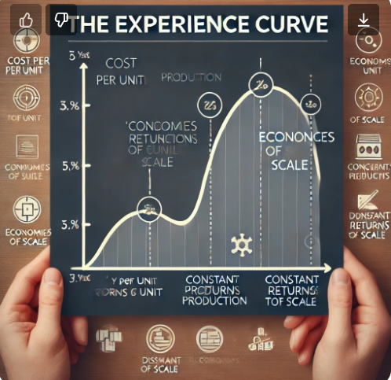
Experience Curve for the Ford Model T, 1909-1920
Notes:
The Experience Curve concept, which was later formalized by Boston Consulting Group in the 1960s, is rooted in the idea that the more a company produces a particular product, the lower the per-unit cost becomes over time. This reduction in cost is largely due to accumulated experience, process improvements, learning effects, and economies of scale.
The Ford Model T (1909–1920) is one of the most famous examples of a product that benefited significantly from the experience curve. The development of the Model T by Ford Motor Company revolutionized manufacturing, lowering production costs dramatically as production volumes increased.
Here’s an overview of how the Experience Curve applied to the Ford Model T between 1909 and 1920:
The Ford Model T and Its Impact on the Automotive Industry (1909–1920)
When Ford launched the Model T in 1908, it was a game-changer in the automobile industry. Prior to the Model T, automobiles were expensive luxury items, often handcrafted and sold in limited quantities. Ford’s goal was to make the car affordable for the average American, and he did so through a strategy of mass production.
Ford's key innovation was the assembly line, which allowed the company to produce cars more efficiently and in much larger volumes. The Model T became incredibly popular due to its affordability, durability, and simplicity, and it was produced in vast quantities from 1909 to 1927.
The Experience Curve and Its Application to the Model T
The Experience Curve describes the phenomenon where a company’s cost per unit decreases as it gains more experience in producing a particular product. The idea is that the more times an activity is performed, the better an organization becomes at performing it, leading to efficiencies and reduced costs.
For Ford’s Model T, the experience curve was evident in the following ways:
Learning Effects: As Ford's workers and managers gained more experience with the assembly process, they discovered ways to streamline production, reduce waste, and improve the quality of the cars.
Process Improvements: The introduction of the moving assembly line in 1913 played a central role in Ford’s cost reductions. This system allowed the workers to specialize in specific tasks and dramatically cut down the time required to produce each car.
Standardization: The Model T was a simple, standardized vehicle, which allowed Ford to use interchangeable parts and keep manufacturing costs low. By using the same parts across all vehicles, Ford achieved greater efficiency in assembly and parts supply.
Key Metrics: Production Time and Costs
Ford’s implementation of the experience curve is best demonstrated by the significant reduction in both production time and costs over the decade from 1909 to 1920:
Reduction in Production Time:
In 1909, the production time for a Model T was approximately 12.5 hours.
By 1914, Ford had reduced this production time to around 93 minutes per vehicle. This dramatic improvement was made possible by the introduction of the moving assembly line, which improved workflow efficiency and allowed workers to specialize in specific tasks.
Cost Reduction:
In 1909, the price of a Model T was approximately $850 (a high price for the time).
By 1920, the price of the Model T had fallen to about $290 due to the significant drop in production costs. This price reduction made the car affordable to a much larger portion of the American public.
The "Doubling Effect" of the Experience Curve
Ford’s experience with the Model T is a textbook example of how the experience curve works. For every doubling of cumulative production, Ford was able to reduce its per-unit cost by a fixed percentage—this is known as the learning curve effect.
Ford’s cost reduction can be summarized by the fact that, as Ford increased production, the cost of producing a single Model T declined consistently due to:
Increased Efficiency: More cars produced meant more experience, leading to improved processes and faster production times.
Economies of Scale: As production volumes grew, Ford was able to negotiate better terms with suppliers, reducing the cost of materials and components.
Technological Improvements: Over time, new machinery and manufacturing techniques further helped reduce costs and improve production.
The Impact on the Auto Industry and the Broader Economy
The experience curve effect that Ford experienced with the Model T didn’t just benefit the company—it had a significant impact on the entire automobile industry and the broader economy:
Market Expansion: As Ford lowered the cost of the Model T, it became affordable to a much broader market. In turn, the automotive industry grew rapidly, and cars became a common part of daily life in America.
Industry Standardization: Ford’s success with standardized production processes pushed competitors to adopt similar methods, making mass production a standard practice in the manufacturing industry.
Boost to Other Sectors: Ford’s innovations in assembly line production also had ripple effects in other industries, including consumer goods and electronics, as companies adopted similar techniques to reduce production costs.
Lessons Learned and Legacy
Ford’s experience with the Model T offers key lessons about the importance of the experience curve in business strategy:
Mass Production is Key to Cost Reduction: By focusing on mass production and scaling up, Ford was able to dramatically reduce the cost of producing each car.
Continuous Improvement: Ford constantly worked to refine and improve its manufacturing processes, ensuring that the company benefited from the experience curve at every stage of production.
Innovation in Operations: Ford’s assembly line innovation transformed manufacturing not just for automobiles but for virtually every mass-produced good.
The legacy of Ford’s experience with the Model T is still felt today, as mass production, continuous improvement, and economies of scale remain central to manufacturing strategies in industries around the world.
The Ford Model T serves as one of the most iconic examples of the experience curve in action. By employing efficient production methods, improving over time, and scaling up its manufacturing operations, Ford was able to reduce the cost of the Model T dramatically over its production run from 1909 to 1920. This not only made the car affordable for the average American but also revolutionized manufacturing techniques that are still applied today. Ford’s experience with the Model T shows how learning effects, process improvements, and economies of scale can lead to significant cost reductions and market expansion over time.

Slide 15
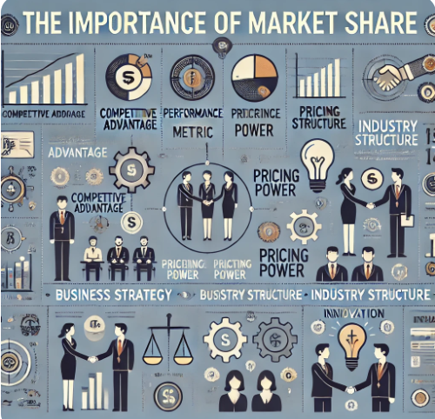
The Importance of Market Share
Notes:
Market share is a critical indicator of a company’s position within its industry and plays a pivotal role in shaping its strategies, competitive dynamics, and long-term sustainability.
Market Share as a Competitive Advantage
A key strategic implication of market share is its potential to confer competitive advantage. A company with a large share in its market can often achieve economies of scale, lowering the unit cost of production and thus increasing profitability. This makes it more difficult for smaller competitors to compete, not just on price but also on innovation and quality. For example, global giants like Amazon or Apple benefit from vast resources that allow them to dominate the market and create barriers to entry for smaller firms.
On the flip side, companies with a small market share may struggle to realize these economies and find themselves at a competitive disadvantage, leading to potential price wars, which could erode margins for everyone involved. Understanding and acting upon market share dynamics can therefore be key to fostering sustained competitive advantage in an industry.
Market Share as a Performance Metric
Market share is a direct measure of a company's performance within its market. It reflects not only the volume of goods sold or services rendered but also indicates a company’s ability to capture consumer attention, loyalty, and trust. High market share is often correlated with strong brand recognition and customer satisfaction. Conversely, a declining market share may signal a loss in customer trust, changing consumer preferences, or increasing competition.
In industries that are experiencing slow growth or decline, maintaining or increasing market share becomes crucial for survival. The importance of market share as a performance metric is therefore paramount, as it can serve as an early warning system for strategists to take corrective actions, such as adjusting the product mix, enhancing customer experience, or exploring new markets.
Market Share and Pricing Power
A company with a significant market share holds substantial pricing power, allowing it to influence prices in the market without the immediate risk of losing a large number of customers. When a company controls a large portion of the market, it can set premium prices or maintain higher prices during periods of inflation or rising input costs. This pricing power is particularly important in industries with high fixed costs, such as telecommunications, airlines, or utilities.
Moreover, pricing strategies related to market share could also influence the strategic moves of competitors. For instance, companies may engage in price cutting or product differentiation to gain a larger share, resulting in a competitive environment that might benefit consumers but hurt industry profitability.
Strategic Implications and Business Strategy
At the corporate strategy level, market share is often a key target in strategic planning. It can drive the allocation of resources across segments, guide investment in research and development (R&D), or inform decisions related to mergers and acquisitions (M&A). For instance, a company aiming to increase its market share might pursue aggressive expansion strategies or even acquire competitors to consolidate its position.
However, it is also important to recognize that the pursuit of market share at all costs might not always align with sustainable profitability. For example, overly aggressive marketing tactics or price wars may increase market share temporarily, but at the expense of margins, long-term customer loyalty, or brand equity. Thus, strategic decisions regarding market share must also consider profitability and long-term viability rather than mere short-term growth.
Market Share and Industry Structure
Understanding market share is crucial for analyzing the structure of an industry, using frameworks like Michael Porter's Five Forces. In an oligopolistic market, for example, a few companies might control the majority of the market share, leading to relatively stable prices and less competition. In contrast, a fragmented industry with many small players may face more competition, driving prices down and increasing customer choice but potentially leading to lower profitability for individual firms.
High market share can lead to a company dominating an industry’s structure, influencing both supplier and buyer power. For instance, large firms may have negotiating power over suppliers, benefiting from lower prices for raw materials or better terms for supply contracts.
Market Share and Innovation
There is an intriguing connection between market share and innovation. Larger companies with substantial market shares typically have more resources for research and development, enabling them to innovate, create new products, and continuously improve their offerings. Conversely, smaller companies may innovate more out of necessity, attempting to carve out niches within the broader market. However, smaller market players may face challenges in funding innovation without access to capital or consumer base needed to test new ideas.
Nonetheless, market share alone doesn't guarantee continuous innovation. In some cases, dominant players may become complacent and fail to innovate, allowing smaller, more nimble competitors to disrupt the market (e.g., the rise of Netflix disrupting traditional video rental businesses like Blockbuster). Therefore, the relationship between market share and innovation requires continuous evaluation to ensure that the company maintains its competitive edge.
Limitations and Ethical Considerations
While market share is important, it's also essential to consider its limitations. Focusing too heavily on market share can sometimes ignore other critical aspects of business, such as sustainability, corporate social responsibility, or customer well-being. Furthermore, aggressive pursuit of market share can lead to monopolistic behaviors, potentially stifling competition and harming consumers in the long run.
Ethical considerations are particularly relevant in industries that are highly regulated or have significant societal impact, such as pharmaceuticals, energy, or technology. An overemphasis on market share might lead to unethical practices, such as manipulating supply chains, environmental degradation, or exploiting labor. These issues emphasize the need for balanced, ethical strategies that promote not just growth but sustainable and responsible business practices.
Conclusion
In conclusion, market share remains an essential metric for assessing a company's competitive strength, operational efficiency, and overall market dominance. However, it must be understood and managed within the context of a broader strategic framework that accounts for factors like profitability, pricing power, innovation, industry structure, and ethical responsibility. While a high market share can signal success, it is not an end in itself; instead, it should align with the long-term goals of the company, ensuring that growth is sustainable, responsible, and aligned with the needs of both consumers and broader society.

Slide 16
Drivers of Cost Advantage
Economies of Scale
Economies of Learning
Production Techniques
Product Design
Input Costs
Capacity Utilisation
Residual Efficiency
Notes:
Drivers of Cost Advantage
A cost advantage occurs when a company can produce a product or service at a lower cost than its competitors while maintaining a comparable level of quality. Companies that enjoy cost advantages are better positioned to outperform competitors, offering lower prices, higher margins, or a combination of both. the key drivers that can lead to a cost advantage are:
1. Economies of Scale
Economies of scale refer to the cost-saving benefits that arise from producing larger quantities of a good or service. As production volume increases, the per-unit cost decreases due to the spreading of fixed costs over a larger number of units, and more efficient utilization of resources. This is typically achieved in the following ways:
Bulk Purchasing: Firms can buy raw materials or components in larger quantities, negotiating lower prices.
Specialization: With higher production volumes, companies can invest in specialized machinery or labor, increasing efficiency.
Operational Efficiency: Larger production runs often lead to fewer setup times and faster production cycles.
The more a company produces, the more it can reduce the average cost per unit, which can provide a significant competitive edge in terms of pricing or profitability.
2. Economies of Learning (or Learning Curve Effects)
As firms produce more over time, they typically become more efficient at their processes due to learning and experience. This is called the learning curve effect. Initially, there are high costs associated with setting up production processes or training workers, but as employees become more skilled and systems are refined, costs per unit drop.
This driver often involves:
Improved Skills: Workers get better at their tasks, reducing errors and the time needed to complete tasks.
Process Improvements: Over time, companies refine production techniques, reducing waste, defects, and inefficiencies.
Knowledge Accumulation: Employees, suppliers, and managers develop more effective ways of solving problems.
Learning curve effects typically result in a sharp decrease in cost during the early stages of production, followed by a plateau as efficiency gains become harder to achieve.
3. Production Techniques
The choice of production techniques plays a major role in determining costs. Advanced and optimized production processes can lead to substantial cost reductions. These techniques might include:
Automation: Replacing human labor with machines can reduce variable costs, such as wages, and increase output consistency.
Lean Manufacturing: Lean techniques aim to eliminate waste and improve efficiency throughout the production process.
Flexible Manufacturing: The ability to quickly change production setups enables companies to efficiently handle different products and demand fluctuations, reducing idle time and excess inventory.
Efficient production techniques reduce the per-unit cost of products and improve overall productivity, directly impacting cost competitiveness.
4. Product Design
The design of a product significantly affects its production cost. Simple, modular, or standardized designs can make manufacturing easier, cheaper, and faster. Some key aspects include:
Standardization: Standardized components can be used across multiple products, reducing procurement and manufacturing complexity.
Design for Manufacturability (DFM): A focus on designing products in ways that make them easier and cheaper to produce (e.g., fewer parts, simpler assembly).
Design for Assembly (DFA): Streamlining the assembly process by reducing the number of steps or components, which can lower labor costs.
A product that is easier and cheaper to manufacture offers cost advantages and may also have improved quality due to fewer production complications.
5. Input Costs
The cost of inputs—raw materials, components, labor, and other resources—directly affects the overall cost structure. Companies can gain cost advantages by securing cheaper inputs, which may come from:
Supplier Negotiation: Large-scale buyers often have bargaining power to secure favorable pricing.
Alternative Inputs: Using less expensive materials or substituting inputs can reduce costs (e.g., switching to less costly substitutes without sacrificing quality).
Outsourcing: Sometimes, outsourcing certain components or processes to locations with lower labor or material costs (offshoring) can lead to a significant reduction in production costs.
Lower input costs allow a firm to either lower its price to remain competitive or maintain margins, thus creating a cost advantage.
6. Capacity Utilization
Capacity utilization refers to how much of a company’s total production capacity is being used. Underutilized capacity leads to inefficiencies and higher per-unit costs, while fully utilizing capacity ensures that fixed costs are spread over the maximum number of units. Key factors include:
Optimal Capacity: Ensuring that production facilities are not underutilized or overburdened can help minimize unit costs.
Flexible Scheduling: The ability to adjust production schedules in response to demand fluctuations ensures that capacity is always used as efficiently as possible.
Fixed Cost Absorption: The higher the output, the more efficiently fixed costs like rent and machinery depreciation are absorbed across products, reducing the cost per unit.
Better capacity utilization directly translates into cost savings and higher profitability.
7. Residual Efficiency
Residual efficiency refers to the company’s ability to maintain operational efficiencies that are not directly attributable to economies of scale, learning effects, or formal processes. It represents the ability to sustain cost advantages over time due to factors like:
Innovative Management Practices: Efficient management can reduce costs through improved decision-making, cost control measures, and process optimization.
Organizational Culture: A company that fosters a culture of efficiency, accountability, and continuous improvement can find ways to reduce waste and enhance productivity.
Strategic Flexibility: Companies that are adaptable to market changes or technological advancements often find innovative ways to reduce costs or improve processes.
Residual efficiency allows a firm to maintain a competitive cost advantage even in the face of changing market conditions or when traditional advantages, like economies of scale, begin to plateau.
Conclusion
The drivers of cost advantage—economies of scale, learning effects, production techniques, product design, input costs, capacity utilization, and residual efficiency—are interrelated factors that shape a company’s ability to offer goods or services at a lower cost than its competitors. Mastering these drivers allows firms to maintain competitive pricing, improve profitability, and strengthen their market position. Each driver contributes to lowering production costs, but the strategic combination and management of these factors are essential for sustainable cost leadership.

Slide 17
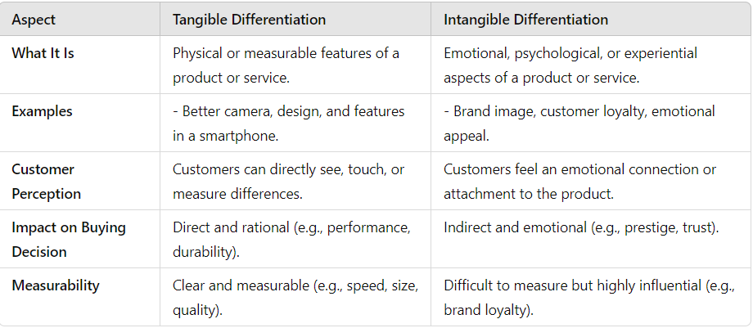
Understanding Differentiation
Notes:
Differentiation is a strategy used by businesses to distinguish their products or services from those of competitors. The goal is to create a unique offering that customers perceive as distinct and valuable, which can justify a premium price or foster customer loyalty. Differentiation can occur in various forms, and it’s often broken down into two main categories: tangible differentiation and intangible differentiation.
Tangible Differentiation
Tangible differentiation refers to the physical or measurable aspects of a product or service that make it different from competitors. These are the features that customers can see, touch, or evaluate directly.
Key Points of Tangible Differentiation:
Product Features: Changes or enhancements in the physical aspects of a product. For example, a smartphone with a larger screen, better camera quality, or longer battery life compared to competitors.
Design: The shape, color, and visual appearance of a product. For instance, luxury cars might have sleek, sophisticated designs that are eye-catching and stand out from the competition.
Quality: Tangible differentiation can also come from better material quality or craftsmanship. For example, a premium leather handbag or high-end sportswear may offer superior durability and craftsmanship compared to cheaper alternatives.
Technology: Products with the latest technological innovations like faster processors in computers, more advanced features in appliances, or even sustainable technologies in products like eco-friendly cars.
Examples of Tangible Differentiation:
Apple’s iPhone: Has physical features like a high-resolution camera, advanced processor, and sleek design.
Tesla Cars: Known for their electric technology, performance, and sophisticated design.
Tangible differentiation is particularly effective when the differences are clear and visible to the consumer, and when these features provide measurable benefits.
Intangible Differentiation
Intangible differentiation involves the non-physical aspects of a product or service—qualities that are not directly measurable or visible but can significantly impact a customer's perception and experience. These are factors related to emotions, associations, or experiences that differentiate a product.
Key Points of Intangible Differentiation:
Brand Image: A strong, recognizable brand identity can create an emotional connection with consumers. For example, brands like Nike or Coca-Cola evoke feelings of trust, prestige, or lifestyle that are difficult to quantify but highly impactful.
Customer Service: Exceptional service that goes beyond the basic expectations can create a loyal customer base. For instance, Zappos is known for its outstanding return policies, free shipping, and friendly customer service.
Reputation: A company’s history and reputation for quality, reliability, or ethical practices can differentiate it in the market. For example, a luxury watch brand like Rolex is not only about the physical watch, but the reputation and status associated with owning it.
Emotional Appeal: Sometimes, products or services are differentiated through their ability to tap into emotional needs or aspirations. For example, a Volkswagen car may be positioned as a car for safety-conscious families, while a BMW is marketed as a symbol of success and sophistication.
Examples of Intangible Differentiation:
Nike: The company differentiates through its brand image and emotional appeal—associated with athleticism, performance, and a sense of empowerment.
Apple: Beyond the features of their products, Apple’s differentiation also stems from brand loyalty, the user experience, and the status symbol it represents.
Amazon: The convenience and speed of its service, alongside its customer-first approach, make Amazon an appealing choice despite its products often being similar to other online retailers.
Intangible differentiation focuses on the perception and experiences that customers associate with a product, and it often involves creating an emotional or psychological connection that goes beyond the physical attributes of the product.
Why Both Matter
Tangible differentiation is often what attracts customers initially—particularly when they are comparing specific attributes like price, quality, or functionality.
Intangible differentiation can strengthen brand loyalty and help companies charge premium prices, as customers often become willing to pay more for a product that aligns with their values or evokes a positive emotional response.
Together, both types of differentiation help create a competitive advantage, making a brand stand out in a crowded market, build stronger customer relationships, and enhance customer retention. Companies that effectively combine both tangible and intangible elements can create a unique market position that is hard for competitors to replicate.

Slide 18
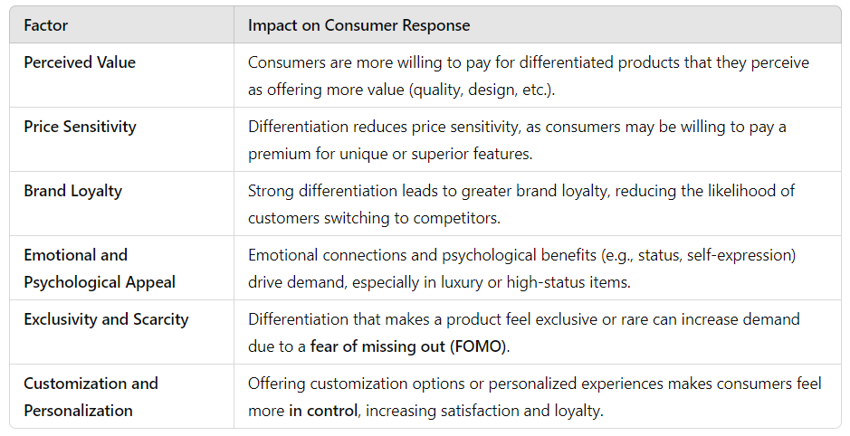
Analyzing Differentiation on the Demand Side
Notes:
When analyzing differentiation from the demand side, we're focusing on how consumers perceive and respond to the unique attributes of a product or service. Differentiation influences how customers make buying decisions, and understanding this aspect can help businesses design strategies that align with consumer preferences and needs.
Key Points of Differentiation on the Demand Side:
1. Consumer Preferences and Needs
Tangible and Intangible Features: Consumers have different needs and preferences that they expect to be met by products. These preferences can be based on both tangible (e.g., product features, design, quality) and intangible (e.g., brand image, customer service, emotional connection) differentiators.
Target Market Segments: By differentiating their products, companies can appeal to specific market segments that have distinct tastes, lifestyles, and purchasing behaviors. For example, some consumers may prioritize product quality while others may care more about brand identity or status.
2. Willingness to Pay
Perceived Value: Differentiation increases the perceived value of a product. If consumers believe a product offers unique or superior benefits (whether tangible or intangible), they may be willing to pay a premium price for it. This is especially true when differentiation is highly visible or emotional.
Price Sensitivity: Differentiation can reduce price sensitivity. Consumers are less likely to switch to competitors solely based on price if they perceive significant value in the differentiated features of the product. For instance, customers may pay more for an Apple product because of the perceived brand prestige and user experience.
Trade-Offs: Sometimes, customers may make trade-offs based on differentiation. They might choose a higher-priced product with unique features that meet their specific needs over a cheaper alternative that lacks those differentiating factors.
3. Brand Loyalty and Customer Retention
Emotional Connection: Intangible differentiation, such as brand image and emotional appeal, plays a significant role in creating customer loyalty. If a brand successfully establishes a strong emotional connection, customers are more likely to become repeat buyers and advocates for the brand.
Switching Costs: Strong differentiation can reduce the likelihood of customers switching to competitors. If customers feel that a product or service is unique to their needs or lifestyle, they are less likely to seek alternatives. Brand loyalty builds over time, making it harder for competitors to attract customers, even with similar offerings.
Customer Experience: Differentiation in terms of customer service, personalized experiences, and post-purchase support can also increase retention. For example, Amazon’s customer-first approach in handling returns and offering easy exchanges has made many customers loyal to the platform.
4. Customer Perception of Quality and Status
Perceived Quality: Differentiated products often create a perception of higher quality, even if the actual product attributes don’t differ significantly from competitors. Luxury goods like high-end watches, cars, or designer clothing are often perceived as superior because of the status they convey, not necessarily because they perform better than other products.
Social Influence: Some differentiation plays into social status or conformity. Consumers may choose products that convey a certain image or align with their identity. Products like BMW, Tesla, or Rolex carry strong social signals, making them more desirable for customers who want to project a specific image or lifestyle.
5. Differentiation Creates Perceived Exclusivity
Unique Product Offerings: When a product or service is highly differentiated, it can create a sense of exclusivity and scarcity. This can lead to higher demand from consumers who want to be among the few who have access to it.
Limited Editions: Brands often use this strategy by creating limited edition products or offering customization options. For example, Nike’s limited-edition sneaker collections or Louis Vuitton’s exclusive product lines appeal to customers who want something exclusive and different from what’s widely available.
6. Increased Consumer Choice and Perceived Control
Variety and Customization: Differentiation provides consumers with more choices, allowing them to select products that better align with their tastes or specific needs. For instance, a car manufacturer offering various models, colors, or customizable features provides consumers with more control over the product they purchase.
Niche Markets: By differentiating, companies can cater to niche markets that may be underserved by mass-market products. For example, companies like Whole Foods cater to health-conscious customers with organic and specialty food products. These consumers are willing to pay higher prices for products that meet their specific preferences.
On the demand side, differentiation plays a key role in shaping how consumers view and value products. It affects their purchasing decisions, willingness to pay, and long-term brand loyalty. Consumers are often willing to pay more for products they perceive as offering unique benefits, whether those benefits are tangible (like better features) or intangible (like emotional appeal or brand identity). Understanding these consumer responses is essential for companies seeking to position themselves effectively in the market and build lasting customer relationships.

Slide 19
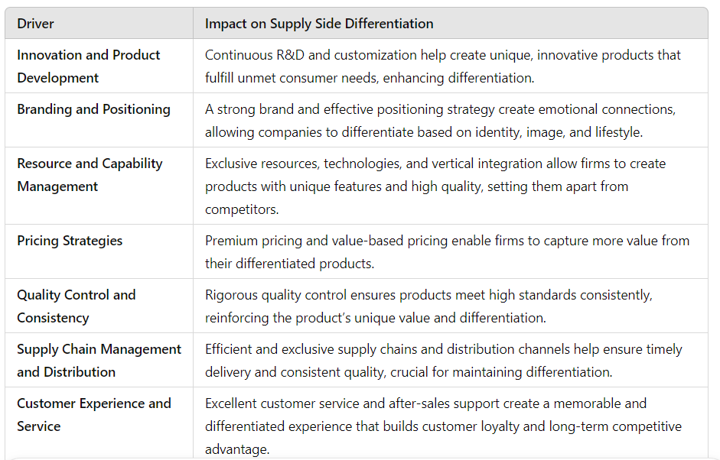
Analyzing Differentiation on the Supply Side
Notes:
Differentiation from the supply side focuses on how businesses or companies can create and deliver unique products or services that stand out in the market. It refers to the strategies and resources used by firms to produce differentiated offerings that meet specific consumer needs or preferences. This involves decisions about product design, production processes, pricing strategies, and the ability to consistently deliver a unique value proposition.
Key Points of Differentiation on the Supply Side:
1. Innovation and Product Development
Continuous Innovation: Firms often invest heavily in research and development (R&D) to create new, innovative products that offer unique features. Innovation might involve developing new technologies, improving product quality, or creating products that serve new or previously unaddressed consumer needs.
Product Customization: Companies may offer customized solutions that appeal to specific customer segments, allowing for differentiation based on personalization. For instance, a company may offer products in a variety of configurations, such as customizable laptops, cars, or clothing. This creates differentiation by catering to individual tastes or requirements.
Example: Tesla differentiates through cutting-edge electric car technology and innovation in autonomous driving features. Their continuous R&D efforts help them stay ahead of the competition and create a unique market position.
2. Branding and Positioning
Strong Branding: A well-developed brand can differentiate a product or service in the eyes of consumers. This involves not only creating a recognizable logo and message but also aligning the company’s mission, values, and image with consumer expectations. Branding plays a crucial role in influencing perceived value and creating emotional appeal.
Market Positioning: Companies position their products or services in a way that emphasizes their uniqueness. This can involve selecting specific market segments and communicating how the product meets those customers’ needs better than alternatives. Positioning can be based on features, lifestyle associations, status, or even a specific type of customer experience.
Example: Apple’s brand is associated with simplicity, premium quality, and innovation. They position their products as high-end, which justifies premium prices and reinforces their differentiation from competitors.
3. Resource and Capability Management
Unique Resources: Some businesses use unique resources or capabilities to differentiate themselves. This can include access to proprietary technologies, exclusive materials, highly skilled labor, or specialized production techniques that cannot easily be replicated by competitors.
Vertical Integration: Companies may vertically integrate by owning and controlling more stages of the production process. This can help ensure the quality and consistency of their differentiated products. For instance, owning the supply chain from raw materials to distribution helps a company maintain control over the quality and costs, which can lead to a more consistent and differentiated offering.
Example: Zara differentiates through fast fashion by maintaining a high level of control over its supply chain, allowing it to quickly respond to market trends and produce unique, up-to-date clothing styles in a shorter time frame.
4. Pricing Strategies
Premium Pricing: Differentiation often allows companies to charge a premium price for their products because they offer something unique that competitors don’t. Premium pricing is commonly associated with products that are perceived as high-quality, exclusive, or innovative. In this case, differentiation helps to justify the higher price point.
Value-Based Pricing: Instead of pricing based on costs, companies might use value-based pricing, where the price is set according to the perceived value that the customer attributes to the differentiated product. This approach is particularly effective when the differentiation appeals strongly to specific consumer segments willing to pay for the perceived benefits.
Example: Rolex uses premium pricing for its luxury watches, leveraging its brand, craftsmanship, and exclusivity to differentiate from lower-priced alternatives. Customers are willing to pay more because of the status, quality, and reputation associated with the brand.
5. Quality Control and Consistency
Superior Quality Control: Maintaining high product quality is often a key differentiator. Companies can establish quality control standards and invest in superior manufacturing processes to ensure that the products meet or exceed customer expectations consistently.
Consistency Across Production: To build and maintain a differentiated product, a company must produce items that consistently meet high standards. For example, a restaurant chain or a luxury brand needs to deliver the same high-quality experience or product every time, which builds customer trust and reinforces its differentiated position.
Example: Toyota is known for its reliable and high-quality vehicles, built through rigorous quality control measures. This consistency in quality has contributed to its strong reputation and differentiation in the automotive market.
6. Supply Chain Management and Distribution
Efficient Supply Chain: Having a well-organized supply chain is essential for delivering differentiated products on time and at the right cost. Differentiation may involve using exclusive suppliers for rare or unique materials, ensuring quick delivery times, or leveraging advanced logistics to create a competitive advantage.
Distribution Channels: Differentiated products are often sold through specific or exclusive distribution channels that match the product’s positioning. This can involve exclusive retail partnerships, direct-to-consumer models, or online platforms. The way a product is distributed plays a key role in maintaining its differentiated status.
Example: Nike differentiates by leveraging its supply chain and exclusive partnerships with top-tier athletes, sports teams, and retailers. They also use direct-to-consumer sales channels, including Nike stores and online platforms, to control the customer experience.
7. Customer Experience and Service
Customer-Centric Approach: Companies that focus on creating a superior customer experience can differentiate themselves from competitors. This includes everything from product packaging to the way the product is sold, used, and serviced.
After-Sales Services: Providing exceptional after-sales services such as warranties, customer support, and maintenance can help companies differentiate themselves from competitors by offering value beyond the initial purchase.
Example: Amazon differentiates itself through exceptional customer service, including fast shipping, an easy return policy, and an efficient customer support system. This reinforces the value customers receive and builds loyalty.
From the supply side, differentiation involves strategically creating and managing resources, capabilities, pricing, branding, and customer service to produce unique products or services. By focusing on innovation, superior quality, brand positioning, and excellent customer service, firms can stand out in competitive markets. Differentiation not only adds value to the product but also aligns with consumers’ specific preferences, which helps companies build a strong, sustainable competitive advantage.

Slide 20
The integrated cost leadership-differentiation strategy
Customers want innovative, high quality, cheap products and fast delivery
Some companies try to combine cost leadership with differentiation
Example:
-Tesco: international food aisle.
- Furniture stores that sell unfinished high-end Furniture.
Risks:
-Overcommitting yourself
-Getting stuck in the middle
Notes:
The Integrated Cost Leadership-Differentiation Strategy
The integrated cost leadership-differentiation strategy involves trying to achieve both low-cost leadership and differentiation at the same time. The goal is to provide consumers with products that offer both innovative features and high quality while maintaining competitive prices. Essentially, the idea is to offer customers more value by combining the best of both worlds: low price and unique features.
This strategy is particularly challenging because it requires firms to balance cost-efficiency with the ability to provide distinctive, high-quality offerings. Some companies succeed in combining these two approaches, but the risks of mismanagement and overextension are significant.
Key Features of the Integrated Cost Leadership-Differentiation Strategy:
Low-Cost Leadership: Companies try to maintain competitive prices by streamlining their operations, reducing waste, improving efficiencies, and leveraging economies of scale. The idea is to offer prices that are lower than those of competitors in order to appeal to cost-conscious consumers.
Differentiation: At the same time, companies aim to differentiate their offerings in some meaningful way—through innovation, better quality, superior customer service, or unique features. The differentiation must add value that makes the product stand out in the eyes of consumers.
Simultaneous Pursuit: The strategy attempts to combine these two goals—offering both a low cost and a distinct product—in order to capture a larger market share. This approach is attractive because it appeals to both price-sensitive customers and those seeking differentiated products.
Examples of Companies Using the Integrated Strategy
Tesco (International Food Aisle): Tesco offers a broad selection of products at competitive prices but also focuses on differentiation through the variety of products, such as international or specialty food aisles. Tesco’s ability to offer low prices while catering to customers' diverse tastes and needs with unique international offerings is an example of this integrated strategy. Customers can shop affordably while getting the unique and high-quality international products they want.
Furniture Stores (Unfinished High-End Furniture): Some furniture stores offer high-end furniture that is sold unfinished, allowing customers to customize or finish the pieces themselves. By doing so, these stores differentiate themselves by offering premium products that are customizable, but they keep costs low by selling unfinished items. The customer benefits from a lower price point while still receiving the quality and uniqueness of high-end furniture.
Risks of the Integrated Cost Leadership-Differentiation Strategy
While this strategy offers the potential for significant rewards, it also comes with several risks:
1. Overcommitting Yourself
Explanation: Trying to achieve both cost leadership and differentiation can stretch resources too thin. Companies may end up investing too heavily in innovation, customer service, or premium product features while also focusing on cost-cutting measures. This can lead to problems with execution, as the company may not have the necessary resources or capabilities to compete effectively on both fronts.
Risk: If a company spreads itself too thin in an attempt to balance both low cost and high differentiation, it may struggle to excel in either area. Overextension can lead to inefficiencies, poor-quality products, or high costs that negate the advantages of low pricing.
Example: A company that tries to offer both luxury features and low prices might face challenges in quality control, supply chain management, and customer service. If it cuts costs too aggressively in certain areas to stay competitive on price, customers may perceive the product as subpar or not worth the premium.
2. Getting Stuck in the Middle
Explanation: This occurs when a company tries to be both a low-cost leader and a differentiated provider but fails to fully achieve either objective. Instead of excelling at one or the other, the company ends up offering a product that’s neither low-cost enough to compete with cost leaders nor differentiated enough to justify a premium price.
Risk: Companies that fail to fully commit to one strategy risk becoming stuck in the middle—unable to compete effectively with either low-cost players or differentiated competitors. Customers may be confused about the value proposition, and the company may struggle to build a strong brand identity or customer loyalty.
Example: A company trying to sell inexpensive, mass-produced electronics with basic features might find itself competing against much cheaper alternatives in the low-cost market or being outdone by higher-end, more differentiated competitors in the premium segment. If they don’t fully stand out in either category, customers may overlook them altogether.
3. Confusing Consumer Expectations
Explanation: When a company tries to do both (offer low prices and differentiation), it can confuse customers about what the product truly offers. If the price is too low to suggest high quality but the product has a premium feature, customers may perceive it as a compromise product or be unsure of its value.
Risk: Customers might question whether the lower price reflects inferior quality, or whether the premium features are really worth the price. Misaligned expectations can lead to poor customer satisfaction and brand confusion.
Example: A company selling premium-quality skincare at low prices might find that customers are skeptical about the product’s true quality or value, thinking that a low price means the product is inferior, even if the ingredients are high-end.
Conclusion:
The integrated cost leadership-differentiation strategy is a highly attractive approach, as it combines the best aspects of both cost leadership and differentiation. However, it requires careful management and strategic focus to avoid overcommitting or getting stuck in the middle. Companies must clearly communicate the value they provide and ensure that both their low-cost and differentiation elements are effectively executed. If done well, it can allow businesses to serve a broad range of customers—those seeking value through low prices and those seeking unique or high-quality products.
To avoid the risks associated with this strategy:
Companies need clear strategic goals and a strong resource management plan.
They must carefully balance cost control with the need to offer products that stand out in the market.
Lastly, clear communication with customers about the product’s value proposition is essential for maintaining brand clarity and customer loyalty.

Slide 21
The Nature of Differentiation: Differentiation and Segmentation
Differentiation and segmentation are fundamental concepts in modern marketing strategies, both crucial in helping businesses gain a competitive advantage and deliver value to their target audiences. While these two concepts are often intertwined, they serve distinct purposes and have unique implications in practice.
Notes:
Differentiation and segmentation are fundamental concepts in modern marketing strategies, both crucial in helping businesses gain a competitive advantage and deliver value to their target audiences. While these two concepts are often intertwined, they serve distinct purposes and have unique implications in practice. Differentiation refers to the process of making a product or service distinct from others in the marketplace, whereas segmentation involves dividing the market into distinct groups based on shared characteristics. The successful execution of these concepts requires a deep understanding of consumer needs, behaviors, and preferences, alongside an ability to innovate and adapt to shifting market dynamics.
Differentiation: Understanding Its Core
Differentiation is a strategic approach businesses use to position their products or services uniquely in the market. By focusing on the attributes, benefits, or experiences that make a product stand out, companies can distinguish themselves from competitors and build a strong brand identity. Differentiation can occur in several dimensions:
Product Differentiation: Changes in the physical characteristics of a product—such as design, quality, features, or performance—allow a company to distinguish its offerings from others in the same category. Examples include Apple's focus on sleek, user-friendly designs or Tesla's unique electric vehicle technology.
Service Differentiation: The manner in which a service is delivered can significantly impact differentiation. For instance, brands like Zappos have built their identity around superior customer service, including fast shipping and hassle-free returns.
Brand Differentiation: A brand's identity, values, and reputation can be powerful differentiators. Companies like Patagonia emphasize sustainability, while others, such as Nike, focus on athleticism, empowerment, and self-expression. Brand differentiation is often about creating a narrative that resonates emotionally with customers.
Price Differentiation: Pricing strategies can be used as a form of differentiation, especially in premium markets or when a brand positions itself as offering value for money. A brand like Rolex differentiates itself through premium pricing, aligning with its luxury, high-status positioning.
Segmentation: Targeting the Right Audience
Segmentation, on the other hand, is the process of dividing the market into smaller, more manageable groups based on shared characteristics. The primary objective of segmentation is to tailor marketing efforts to specific audience segments rather than adopting a “one-size-fits-all” approach. There are several key forms of segmentation:
Demographic Segmentation: This approach divides the market based on characteristics such as age, gender, income, education, occupation, and family size. For instance, luxury brands might focus on high-income individuals, while fast-food chains may target younger, lower-income consumers.
Geographic Segmentation: Markets can also be segmented by location, where businesses tailor their offerings to different regions, cities, or even countries. Geographic segmentation allows companies to adapt to regional preferences, climate differences, and cultural nuances.
Psychographic Segmentation: This involves categorizing customers based on lifestyle, personality, values, or social status. Psychographic segmentation enables brands to align with deeper motivations, such as health-consciousness or environmental sustainability.
Behavioral Segmentation: Behavioral segmentation divides consumers based on their buying habits, usage frequency, and brand loyalty. For instance, brands often target heavy users of their products with special offers or loyalty programs to increase retention.
The Interplay Between Differentiation and Segmentation
While differentiation focuses on distinguishing a product or service, segmentation seeks to find the most profitable customer groups to target. The two strategies work synergistically to maximize the effectiveness of marketing campaigns:
Targeted Differentiation: Once a market is segmented, differentiation strategies can be tailored to meet the needs and preferences of each segment. For example, a company like Coca-Cola differentiates its products by segmenting the market into categories like health-conscious consumers (e.g., Diet Coke) and traditional soda drinkers (e.g., Coca-Cola Classic).
Niche Segmentation with Differentiation: By targeting niche segments, companies can focus on delivering highly specific, differentiated products that cater to the needs of a small but loyal customer base. The success of companies like Tesla is an example of this, where segmentation based on environmental values and luxury preferences was coupled with a highly differentiated product offering.
Ethical Considerations and Challenges
There are several ethical considerations and challenges that arise when employing differentiation and segmentation strategies:
Consumer Privacy: Behavioral segmentation, especially in the digital age, raises concerns about privacy and the ethical use of consumer data. Marketers must strike a balance between personalizing offerings and respecting customer privacy.
Exclusivity and Inclusivity: While targeting premium segments through differentiation can be lucrative, it also risks alienating larger, more diverse audiences. Brands must be cautious of creating exclusive products that fail to promote inclusivity or accessibility.
Market Saturation and Innovation: Differentiation can lead to market fragmentation, where too many players compete within narrow niches, leading to saturation. Businesses must continually innovate to avoid becoming obsolete in an oversaturated market.
The strategic use of differentiation and segmentation plays a critical role in shaping a company’s market position and competitive advantage. While differentiation focuses on standing out from the crowd, segmentation allows businesses to pinpoint and understand their most valuable customer groups. Together, these strategies help companies craft targeted, meaningful, and compelling offers that resonate with specific consumer segments. However, it is essential that businesses remain mindful of the ethical implications and the challenges inherent in these strategies, ensuring that their efforts foster long-term, sustainable growth and customer loyalty.

